Slide 1
New actors in online intermediation/promotion
Real-Life Scenarios to Frame Key Issues
The digital marketplace extends beyond traditional e-commerce.
New players like streamers, influencers, and AI agents reshape how goods are promoted and sold.

Slide 2
Legal Frameworks Struggle to Keep Pace
Distribution Control
Emerging models challenge existing control over product distribution.
Consumer Protection
New forms raise questions on safeguarding consumers effectively.
Platform Liability
Accountability for platforms becomes complex in new digital roles.
Intellectual Property
Enforcement mechanisms face hurdles amid evolving commerce channels.

Slide 3
Cross-Border Dynamics in Digital Commerce
Global Spread
Blended Roles
Sellers, platforms, and consumers operate across multiple jurisdictions.
Mix of roles increases regulatory complexity and accountability gaps.
Legal Uncertainty
Diffused responsibilities raise challenges in enforcement and compliance.

Slide 4
Case 1: Live Stream Shopping and Accountability
Incident
Significance
Legal Focus
Viya fined ~$210M for tax evasion in 2021.
Tax compliance for digital sellers
Raises questions on streamer responsibility and platform transparency.
Influencer liability
Platform duties in B2C models
Influencers and Supplier Liability

Slide 5
Case 2: IP Violations in Real-Time Sales
Event
Seller promoted counterfeit AGATHA bags on Douyin.
Court Ruling
Douyin held liable under e-commerce platform obligations.
This is the first IP case in which a Chinese court has treated a livestreaming marketing platform as a traditional e-commerce platform; it is also the first case of its kind to be decided since implementation of the Administrative Measures for Online Live-Streaming Marketing (for Trial Implementation).

Slide 6
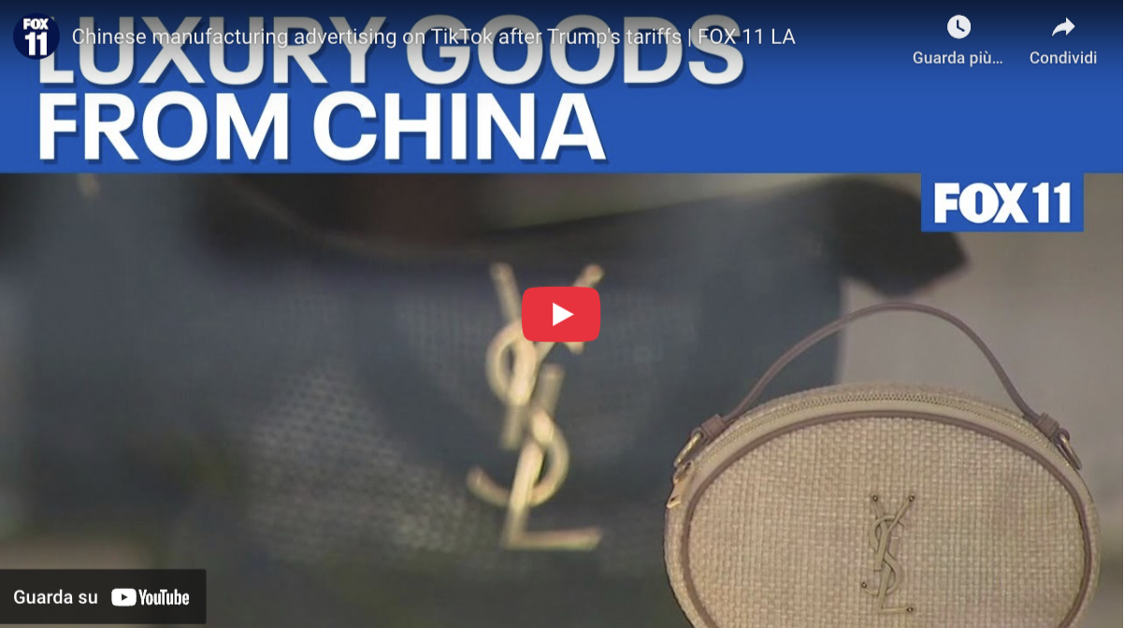
https://www.youtube.com/watch?v=JXpEy93OLiA

Slide 7
Overview of distribution networks and sales restrictions
supplier challenges and regulatory implications

Slide 8
Online intermediation services and competition Law
EU Guidelines on vertical restraint
“Undertakings active in the online platform economy play an increasingly important role in the distribution of goods and services. They enable new ways of doing business, some of which are not easy to categorise using the concepts applied to vertical agreements in the brick and mortar environment."
“Undertakings active in the online platform economy are often qualified as agents in contract or commercial law. However, this qualification is not material for the categorisation of their agreements under” competition law.
online intermediation services are defined as “information society services which allow undertakings to offer goods or services to other undertakings or to final consumers, with a view to facilitating the initiating of direct transactions between undertakings or between an undertaking and a final consumer, irrespective of whether and where the transactions are ultimately concluded.”
“The scope of the relevant market depends on the facts of the case, in particular the degree of substitutability between online and offline intermediation services, between intermediation services used for different categories of goods or services and between intermediation services and direct sales channels.”

Slide 9
Online intermediation services and competition Law
Price management
Under EU and French Law, it is not allowed to fix a resale price or minimum price
Agency agreements
“Under certain circumstances, the relationship between an agent and its principal may be characterised as one in which the agent no longer acts as an independent economic operator. This applies where the agent bears no significant financial or commercial risks in relation to the contracts concluded or negotiated on behalf of the principal.” ( Guidelines 2022/C 248/01)
Most-favoured-client
“The exemption … shall not apply to the following obligations contained in vertical agreements … (d) any direct or indirect obligation causing a buyer of online intermediation services not to offer, sell or resell goods or services to end users under more favourable conditions via competing online intermediation services;” (Regulation 2022/720 of 10 May 2022 article 5 §1 d)
Abuse of domination and unfair practice
Unfair business-to-consumer commercial practices
Smear campaign, parasitism, etc.

Slide 10
Suppliers challenge
Organize / modify its relationships with its distribution network to take into consideration those new players
Ensure consistency with the distribution network
Ensure compliance with regulations

Slide 11
Coexistence with the networks
Exclusive distribution
The intermediation agreement should not infringe the territorial exclusivity granted to the distributor
The intermediation agreement should not implement an active sale on a territory granted to an exclusive distributor
Selective Distribution
The intermediation agreement should respect the selective criteria
If the criteria limits/regulates online sales, they should be adjusted
A control of the sales should be implemented to ensure the integrity of the distribution network
If the distribution agreement limits the sale on the internet (e.g., via the marketplace) the sale via live streaming must be given special attention
Franchising
The Franchisor should respect the know-how to do not weaken its network

Slide 12
Risk of damaging the image and reputation of the brand
In France in 2022 / 2023:
50% of influencers does not comply with French Law
Mainly unfair practices or default of indication of the commercial nature of their activities)
French Law No. 2023-451 of June 9, 2023, aimed at regulating commercial influence and combating the excesses of influencers on social networks
Natural or legal persons who, for a fee, use their notoriety among their audience to communicate to the public, electronically, content aimed at promoting, directly or indirectly, goods, services or any cause, are carrying out the activity of commercial influence by electronic means.
The promotion of goods, services or any cause carried out by the persons mentioned in Article 1 must be explicitly indicated by the mention “Advertising” or the mention “Commercial Collaboration”.
Difficulty to control the communication of the live streamer / personal shopper
Risks of liability of the supplier in the event of unfair practice (e.g., disparagement, parasitism, etc.)

Slide 13
Risks in relation with a requalification of the intermediation agreement
As an intermediary agreement there is a risk of requalification in self-employed commercial agents (EU Directive 86/653/EEC) if:
"self-employed intermediary who has continuing authority to negotiate the sale or the purchase of goods on behalf of another person, hereinafter called the 'principal', or to negotiate and conclude such transactions on behalf of and in the name of that principal”
Employment contract:
“the disputed agreements imposed on the athletes concerned the obligation, in return for payment, to wear the brand's equipment in order to promote it at various events, so that these contracts were presumed to be modeling employment contracts” (French Supreme Court, 12 May 2021, 19-24.610)

Slide 14
China’s Livestream Economy - The New Retail Theatre

Slide 15
Welcome to China’s Livestream Economy
A Dominant Force in China's Digital Landscape
Over 700 million livestream viewers in China as of 2023, accounting for more than half of the country's internet users.
Livestreaming e-commerce generated approximately $695 billion USD in Gross Merchandise Value (GMV) in 2023
MCNs and top streamers play a pivotal role
Livestreaming transcends entertainment
It’s not just content. It’s commerce — and power.
*source: https://www.shine.cn/news/in-focus/2411283922/#:~:text=What%20began%20as%20a%20niche,training%20subsidies%20and%20skills%20certification.; https://ecdb.com/blog/livestream-commerce-in-china-taobao-leads-but-its-dominance-fades/4598

Slide 16
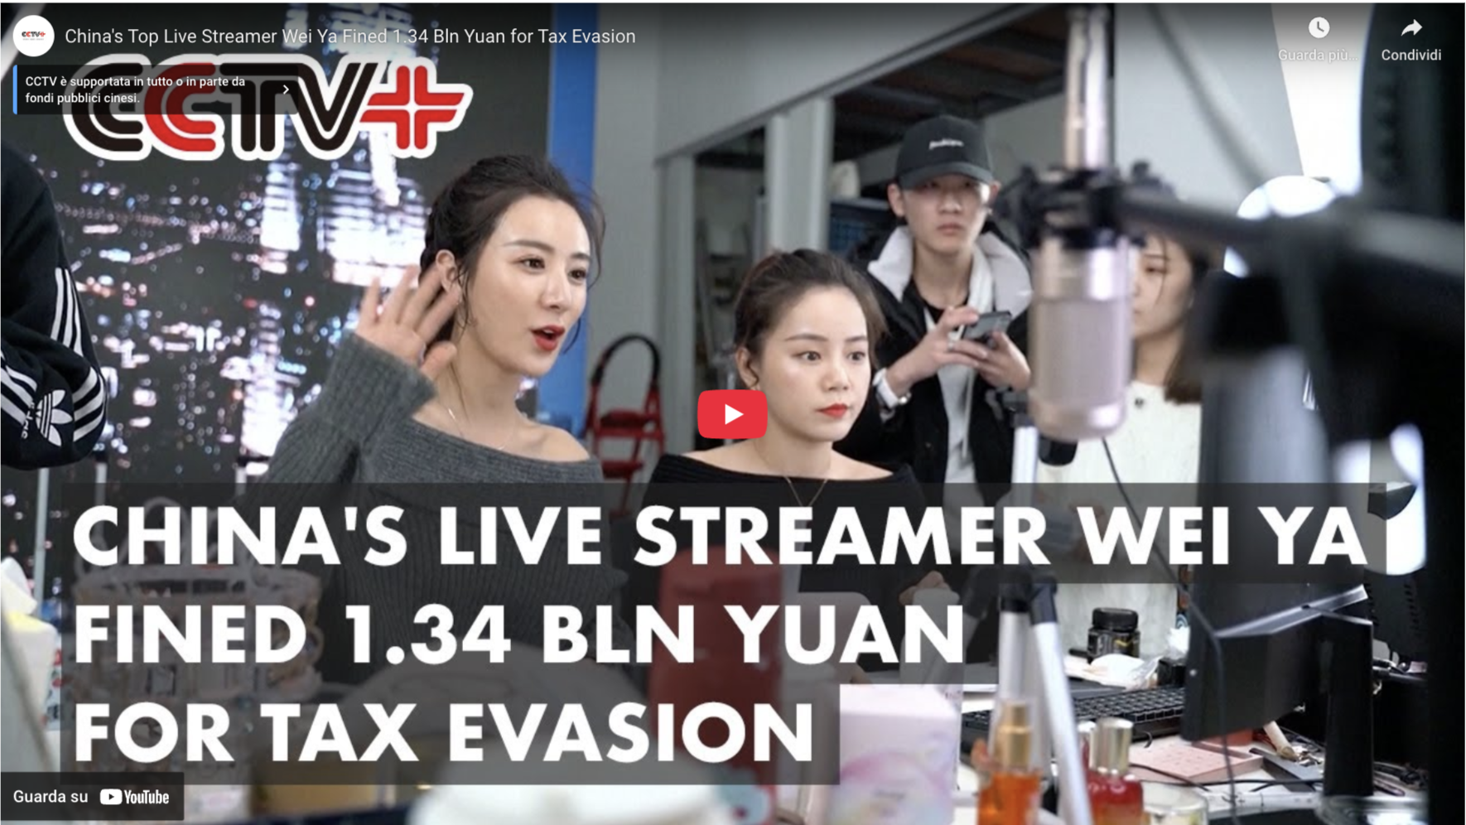
https://www.youtube.com/watch?v=P_YDIaoEwEo

Slide 17
China’s Livestream Economy - The New Retail Theatre
Livestreaming in China is a vast, multi-layered ecosystem.
Three types of live-streamers
I. Platform-Signed Streamers
II.MCN-Affiliated Streamers (Today’s focus)
III. Independent / Individual Streamers

Slide 18
The role of MCN
Definition: MCN = Multi-Channel Network, functions as an influencer management agency
Services Offered: Branding, marketing, copyright handling, and monetization solutions
Creator Support: Helps streamers, vloggers, and KOLs focus on content while ensuring revenue streams
Objective: Build a content ecosystem that attracts followers and revenue
First formal definition proposed in China (but not yet in force):
“MCNs are entities registered with content platforms that provide planning, production, marketing, and agency services and other related services to online content creators.”
— Administrative Provisions on Multi-Channel Network (MCN) Institutions for Online Information Content Distribution – Draft for Comments (2025, Draft for Comment) https://www.cac.gov.cn/2025-01/10/c_1738209405008163.htm

Slide 19
The Problem: “Lowest Price Across the Internet”
What’s the catch?
MCNs often demand “全网最低价” (lowest price across all platforms)
Refuse — and risk being shut out from key livestream channels
The issue: Not just pricing — but platform power and market dominance
“买贵退差价” - best price guarantee

Slide 20
L’Oréal & Li, Jiaqi, Viya – A Pricing backfire (2021)
L’Oréal promised “best deal of the year” on livestreams
Fans later found lower prices on Tmall via coupons
Result: Consumer backlash, influencer fallout, public apology
Lesson: Misaligned pricing across channels damages trust

Slide 21
JD.com & Hauswirt Toaster, Li, Jiaqi Dispute (2023)
JD.com sold a toaster cheaper than Li Jiaqi’s livestream
Violated “lowest price” clause with his MCN, MeiOne
Hauswirt risked penalties; JD.com defended its pricing strategy, stating that the discount was subsidized by the platform, not the brand.
Lesson: Enforcing price exclusivity can spark conflict

Slide 22
Legal Risks
Most Favored Nation (MFN) Clauses
Requires seller to offer best available terms (e.g., lowest price) to select partners
Livestreamers may have relied on MFN-style terms in their promotions
Offering lower prices on other platforms can trigger breach disputes

Slide 23
Legal Risks
Resale Price Maintenance (RPM)
Occurs when brands fix or restrict resale prices
Suppliers may have attempted indirect control over pricing across platforms
RPM is generally prohibited under China’s Anti-Monopoly Law (AML)
Legal risk: May restrict competition and distort market pricing

Slide 24
Relevant laws in China
Anti-Monopoly Law
Article 22: Prohibits abuse of market dominance. Key considerations include whether a party is:
• Unreasonably restricting transactions, or
• Imposing unfair trading conditions inf business dealings
Advertising Law
Article 28: False advertising (misleading price/benefit claims)
Article 56: The advertiser (i.e., the brand) bears primary responsibility for the truthfulness of the advertisement. If a livestreamer makes false claims, the brand may be jointly liable and subject to penalties.

Slide 25
Relevant laws in China
Price Law
Article 14: Prohibits false price promotions and price discrimination
Consumer Rights Protection Law
Article 8: Right to know
Article 55: Fraud penalties (refund + 3x compensation)

Slide 26
Good News: Regulatory Guidance Emerging
Growing regulatory attention on livestream sales activities.
“Compliance Guidelines for Online Livestream Marketing Activities” – issued by the Market Regulation Bureau of several cities. For example, Shanghai: http://scjgj.sh.gov.cn/cmsres/55/559510d417ef4d06bf77421eedf0bee9/cea01ad6efac25ae8bc3b565ed2fc854.pdf
Explicitly requires that live streamers shall not require platform merchants to sign ‘lowest price agreements’ or other unfairly exclusive or coercive clauses.

Slide 27
Dilemma for brands in China
Sales volume or Pricing Power? — A Tough Choice
Top streamers demand lowest price across the internet
→ Risk of being shut out of major sales events like Double 11 if refused
Livestream platforms reward deep discount
→ Traffic algorithms favor cheap deals over brand value
→ Consumers trained to chase price
Brand control
→ Harder to enforce consistent brand messaging and premium positioning
Compliance costs
→ Brands may be liable for influencer misstatements

